Slide 1
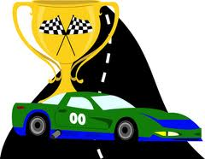
NDA – National Day of Action
Imagine your school without bullying!
ORAN PARK
PUBLIC SCHOOL

Slide 2
Senior Focus (Stage 3)
Core Values:
We are learning to be safe and proud students
We are learning about bullies and bystanders
We are learning how to deal with playtime issues
We are learning about appropriate behaviour/bullying before and after school hours

Slide 3
THEME: Imagine your school without bullying…..
ORAN PARK
PUBLIC SCHOOL

Slide 4
What is a bully?
Bullying is when someone:
Keeps picking on you and consistently tries to make you feel bad
Says horrible or nasty things to upset you most of the time
Makes fun of you a lot
Tries to stop you from joining in with games
Tries to make other people not like you
Keeps hurting you, such as hitting or punching you
Remember it is not bullying if you have a disagreement or argument with someone one time. It is not bullying even though it can be upsetting. It is also not bullying if you sometimes fight with a friend and you can sort it out.

Slide 5
Reasons people may bully…
When people bully, it might be because:
They think it is cool
They get angry about something and take it out on someone else
They don’t know how to get along with others
They think it is funny to hurt people
They think other people will laugh too

Slide 6
Bystanders….
Bullying situations usually involve more than the bully and the victim. They also involve bystanders. Bystanders are those who watch bullying happen or hear about it.
There are two types of bystanders:
Helpful bystanders – People that help the person being bullied or tells someone (like a grown up) what is happening.
Hurtful bystanders – Someone that does nothing or
joins in on the bullying.

Slide 8
What can you do if you see a bully or are being bullied?
Follow our 2 and 3 step plan!!!

Slide 9
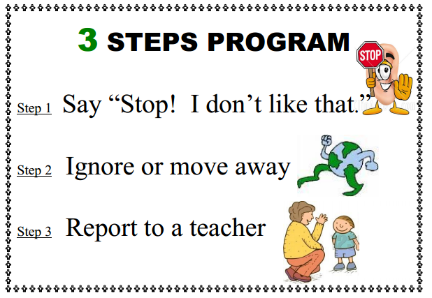
Playtime
Our 3-step plan - Bullying

Slide 10
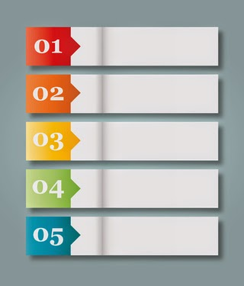
Our 3-step plan
Activity: When should we use the 3-step plan? List them down on the board.

Slide 11
What do you do?
If someone says to you “stop I don’t like that!”
What should you do?

Slide 12
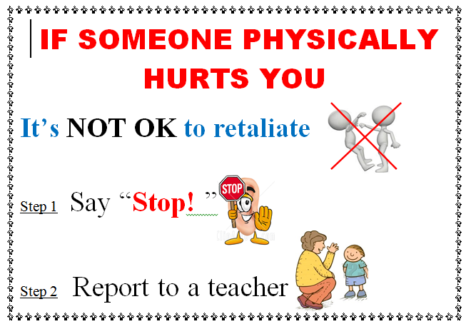
Playtime:
Our 2-step plan - Violence

Slide 13
Our 2-step plan
Activity: When should we use the 2-step plan? List them down on the board.

Slide 14
Always remember to tell a teacher!!
A teacher can only help fix problems that they know about. So always let your teacher know if you are hurt or are being bullied!

Slide 15
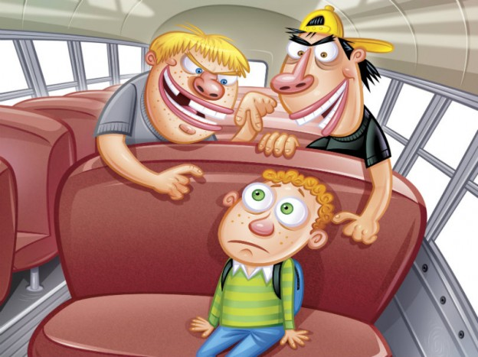
Bullying in the Community
Bullying situations do not just occur within school.
Everyone need to be aware of bullying occurring anytime and anywhere.
Bullying can occur:
During the bus ride to school
Walking to school
At the shops
Riding our bikes with friends
On the internet

Slide 16
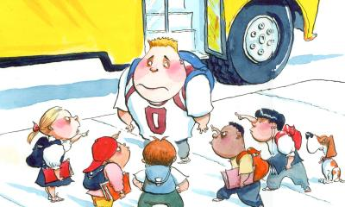
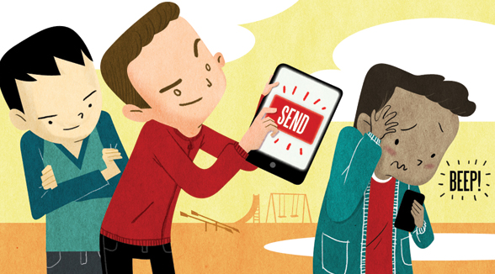
Bullying in the Community
You as an individual need to think about whether or not you are going to be a positive or negative bystander in these situations.
Some things that you can do to help:
Inform the teachers at school of the bullying – especially if it is occurring when travelling to or from school
Inform your parents of any bullying situations you witness or experience outside of school.
Do not forget bullying is not a one time thing, it is a reoccurring abuse of power.

Slide 17
Activity
Brainstorm with your class some anti bullying statements.
E.g. ‘I can make difference’
‘Say no to bullying’
Develop an individual anti bullying statement on your whiteboards (feel free to help each other / think pair share).
Once everyone has a statement and some people have shared theirs move on to creating an
‘Imagine a school with no bullying’ wall to block bullying’
Where you will write your statement and decorate your cloud.
Glue your clouds onto your butchers paper to create an NDA – Anti Bullying display.
(Bricks)

Slide 18
Extra Activity
If students finish their bricks they may form a group and begin to practice the bullying role plays that can be found on the - google drive – NDA - Stage 3 folder

