Slide 1
National Day of Action Against Bullying and Violence
Friday 16th March 2018

Slide 2
https://bullyingnoway.gov.au/resources/videos/pages/videoplayer.aspx?VideoID=183
What is bullying?
- Bullying is an ongoing misuse of power in relationships that causes physical and/or psychological harm.
What are the types of bullying?
- verbal, physical and social

Slide 3
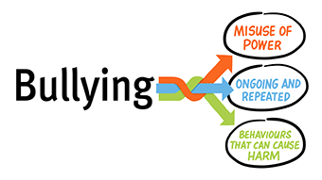

Slide 4
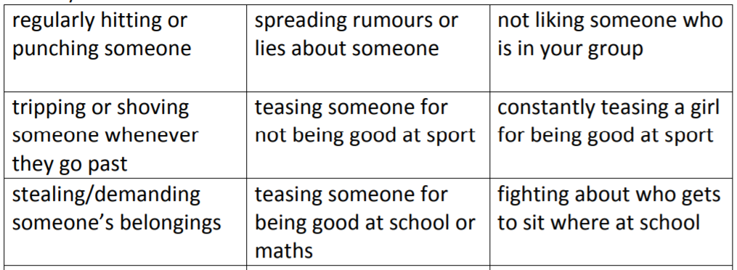
Which of the following behaviours are physical bullying?

Slide 5
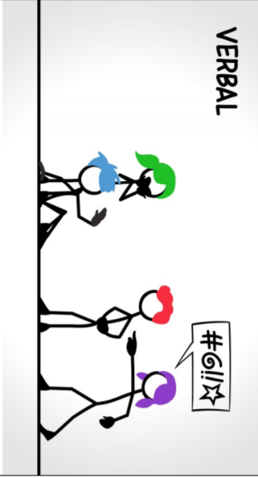
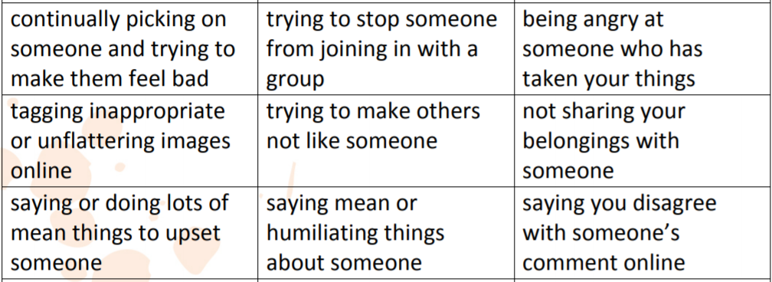
Which of the following behaviours are verbal bullying?

Slide 6
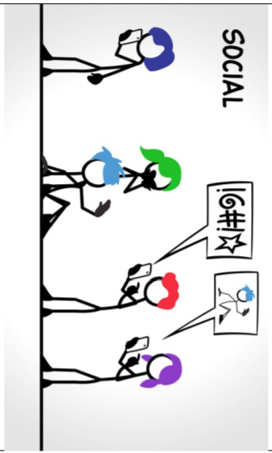
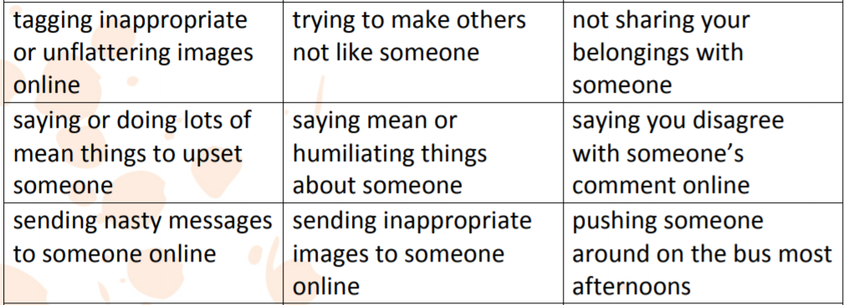
Which of the following behaviours are social bullying?

Slide 7
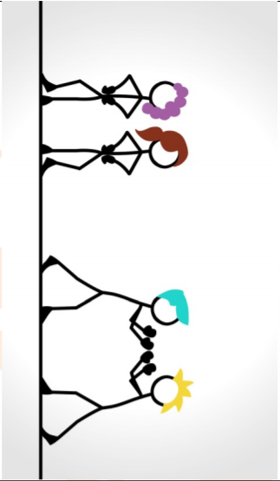
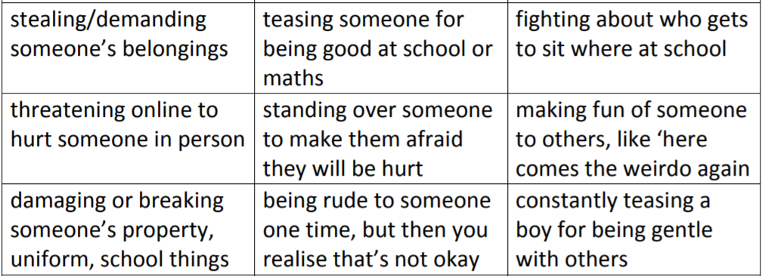
Which of the following behaviours are NOT bullying?

Slide 8
What are some strategies we can use if bullying happens?
Brainstorm ideas

Slide 9
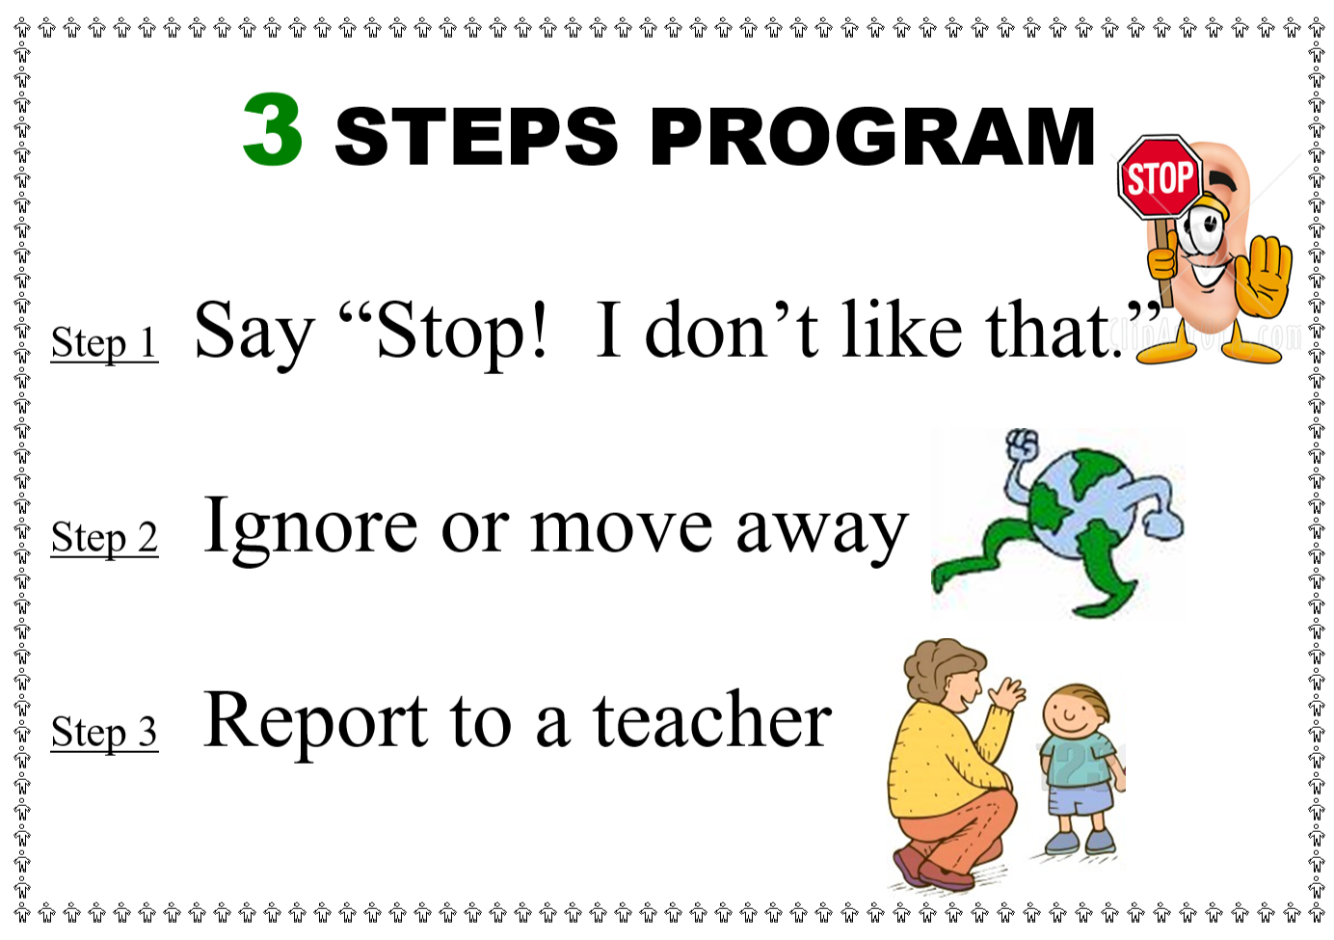
What are the strategies we use at OPPS?

Slide 10
Create a poster, “Imagine a world without bullying”
Take a photo in a thinking pose or draw a self-portrait
Draw a thinking bubble
Fill your thinking bubble with as picture or writing about what a world without bullying would be like.

