Slide 1
National Day Against Bullying 16 March 2018
Early Stage One

Slide 3
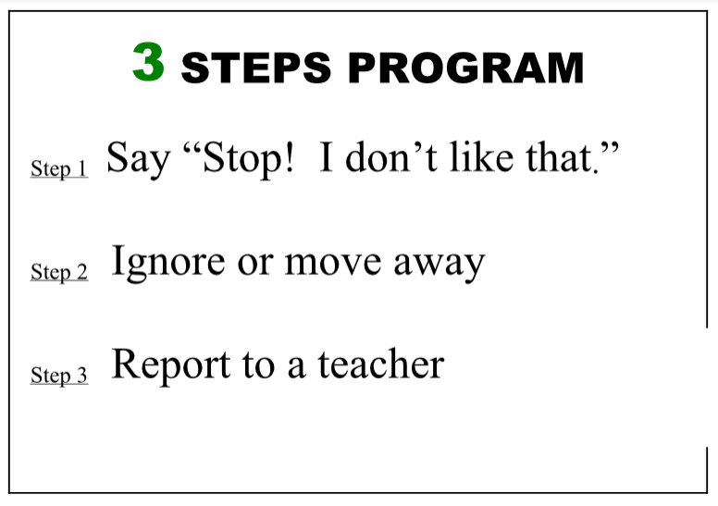

Slide 4
WHAT IS BULLYING? Click on the Speaker to watch and discuss

Slide 5
Watch Chapter 1 – The New Kid.

Slide 6
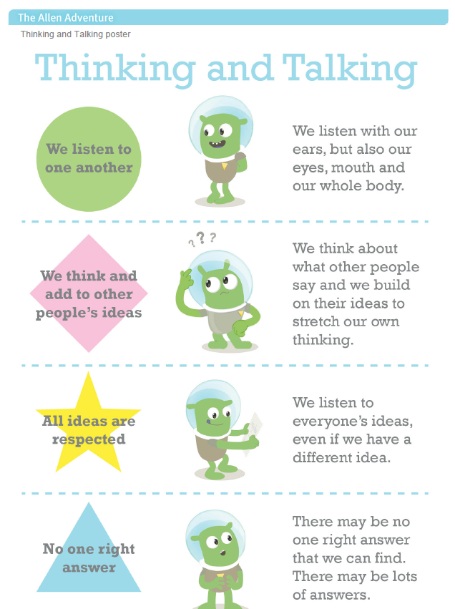

Slide 8
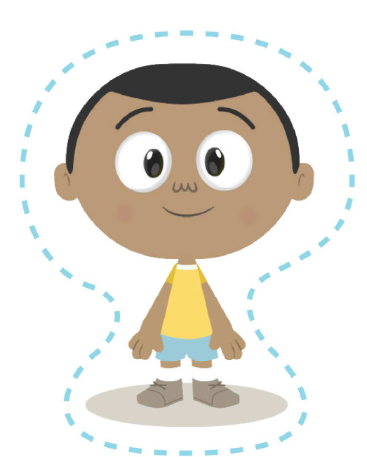
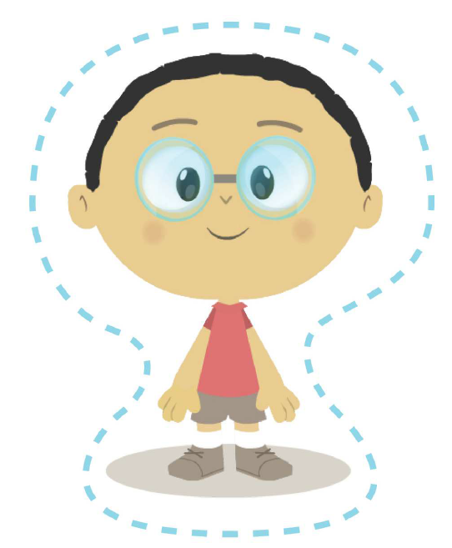
Whole class Role Plays!

Slide 9
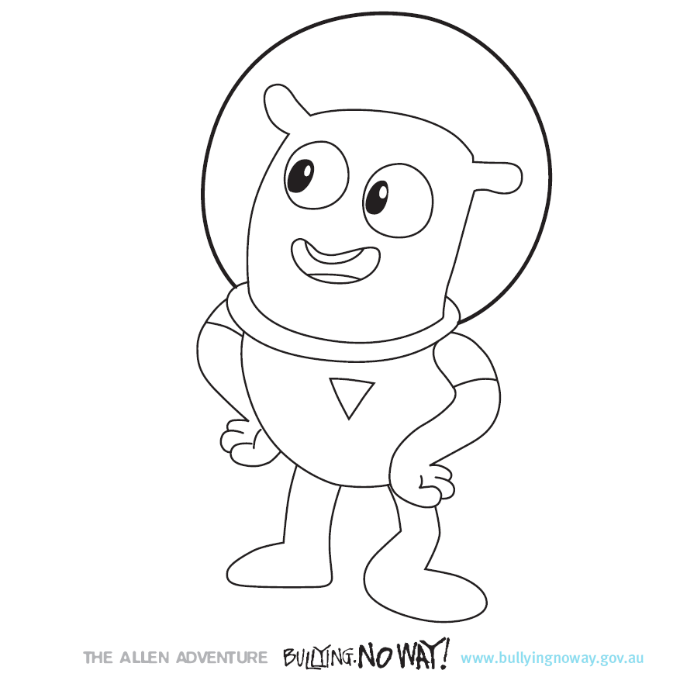
What did we learn today?

