Slide 1
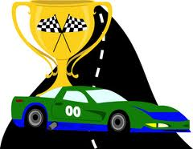
Positive Behaviour for Learning
ANTI-BULLYING
ORAN PARK
PUBLIC SCHOOL

Slide 2
Junior Owls (Early Stage 1 & Stage 1)
We are learning to be safe students
We are learning to spot a bully
We are learning to tell a teacher
Senior Owls (Stage 2 & 3)
We are learning to be safe and proud students
We are learning how to spot a bully
We are learning about bystanders

Slide 3
Junior Owls (Early Stage 1 & Stage 1)
Core Values:
We are learning to be safe students
We are learning to spot a bully
We are learning to tell a teacher

Slide 4
Think, pair, share….
What is a hero?
What makes a hero awesome?
How can you be a hero at school?

Slide 5
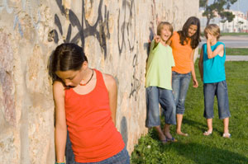
Bullies…..
Bullies are NOT heroes!!!

Slide 6
What is a bully?
Bullying is when someone:
Keeps picking on you all the time
Tries to make you feel bad all the time
Makes fun of you a lot
Makes others not like you
Keeps hurting you such as hitting or punching
Remember it is not bullying if you have a fight or argument with someone once, it is not bullying even though it can be upsetting. It is also not bullying if you sometimes fight with a friend and you can sort it out.

Slide 7
Why do people bully?
Activity: Discuss with your class the possible reasons people may bully others.

Slide 8
What can you do if you see a bully or are being bullied?
Follow our 2 and 3 step plan!!!

Slide 9
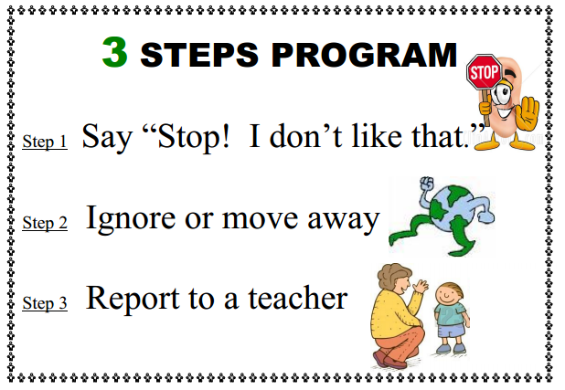
Our 3-step plan

Slide 10
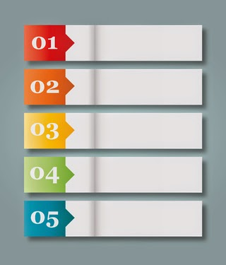
Our 3-step plan
Activity: When should we use the 3-step plan? List them down on the board.

Slide 11
What do you do?
If someone says to you “stop I don’t like that!”
What should you do?

Slide 12
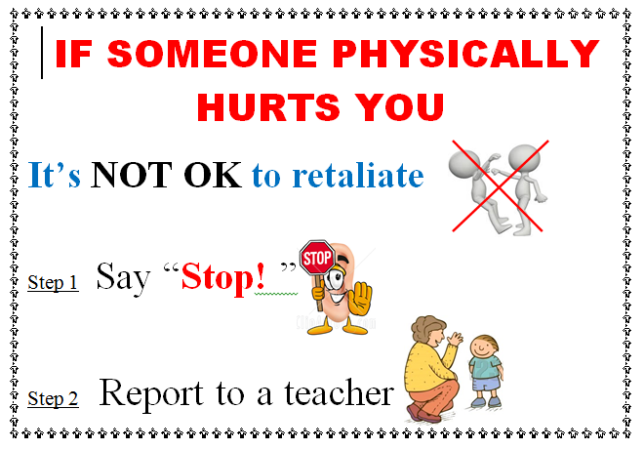
Our 2-step plan

Slide 13
Our 2-step plan
Activity: When should we use the 2-step plan? List them down on the board.

Slide 14
Always remember to tell a teacher!!
A teacher can only help fix problems that they know about. So always let your teacher know if you are hurt or are being bullied!

Slide 15
Food for thought…
https://bullyingnoway.gov.au/resources/videos/pages/videoplayer.aspx?VideoID=29
Question: What has happened in this video?

Slide 16
Senior Owls (Stage 2 / Stage 3)
Core Values:
We are learning to be safe and proud students
We are learning how to spot a bully
We are learning about bystanders

Slide 17
Think, pair, share….
What is a hero?
Why is someone considered a hero?
Do all heroes have super powers?
How can you be a hero at school?

Slide 18
Bullies…..
Bullies are NOT heroes!!!

Slide 19
What is a bully?
Bullying is when someone:
Keeps picking on you and consistently tries to make you feel bad
Says horrible or nasty things to upset you most of the time
Makes fun of you a lot
Tries to stop you from joining in with games
Tries to make other people not like you
Keeps hurting you, such as hitting or punching you
Remember it is not bullying if you have a disagreement or argument with someone one time. It is not bullying even though it can be upsetting. It is also not bullying if you sometimes fight with a friend and you can sort it out.

Slide 20
Why do people bully?
Activity: Discuss with your class the possible reasons people may bully others.

Slide 21
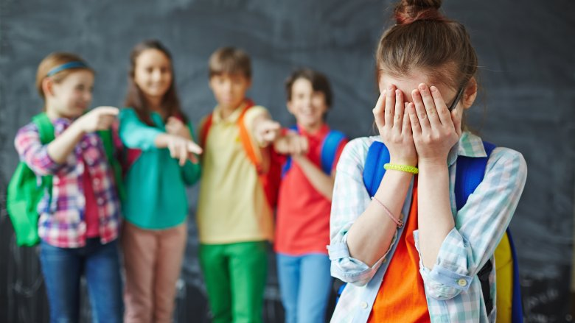
Reasons people may bully…
When people bully, it might be because:
They think it is cool
They get angry about something and take it out on someone else
They don’t know how to get along with others
They think it is funny to hurt people
They think other people will laugh too

Slide 22
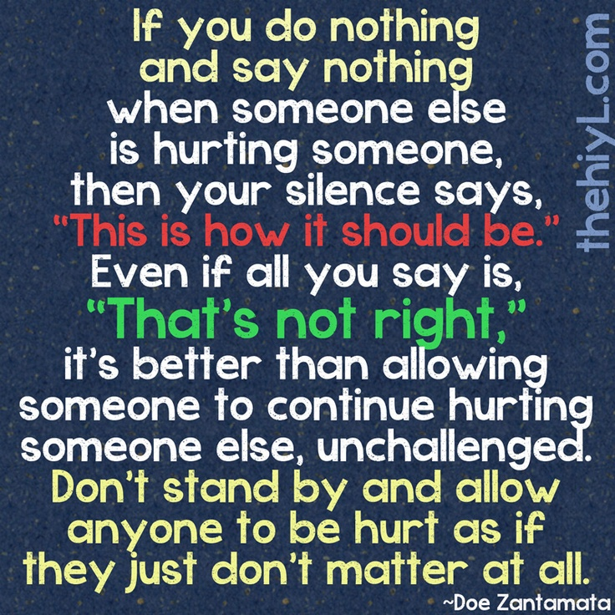
Bystanders….
Bullying situations usually involve more than the bully and the victim. They also involve bystanders. Bystanders are those who watch bullying happen or hear about it.
There are two types of bystanders:
Helpful bystanders – People that help the person being bullied or tells someone (like a grown up) what is happening.
Hurtful bystanders – Someone that does nothing or
joins in on the bullying.

Slide 23
What can happen if you don’t speak out….
Activity:
Take an A4 piece of paper and fold it
Then fold it again
Then scrunch the paper
Move on to the next slide and read.

Slide 24
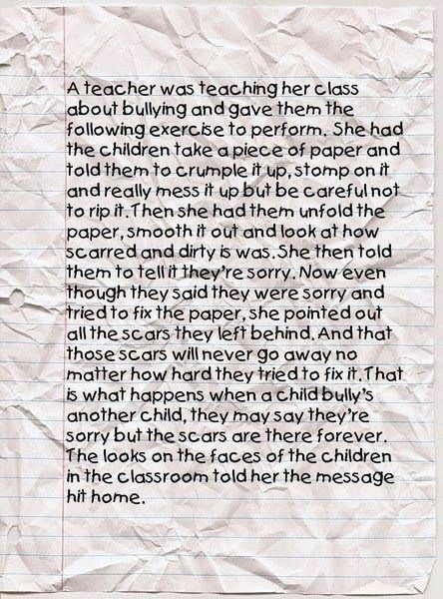

Slide 25
What can you do if you see a bully or are being bullied?
Follow our 2 and 3 step plan!!!

Slide 26
Our 3-step plan

Slide 27
Our 3-step plan
Activity: When should we use the 3-step plan? List them down on the board.

Slide 28
What do you do?
If someone says to you “stop I don’t like that!”
What should you do?

Slide 29
Our 2-step plan

Slide 30
Our 2-step plan
Activity: When should we use the 2-step plan? List them down on the board.

Slide 31
Always remember to tell a teacher!!
A teacher can only help fix problems that they know about. So always let your teacher know if you are hurt or are being bullied!

Slide 32
Food for thought…
http://www.youtube.com/watch?v=wT3RhIJZu4k
Question: What is this video about?

