Slide 2
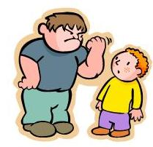
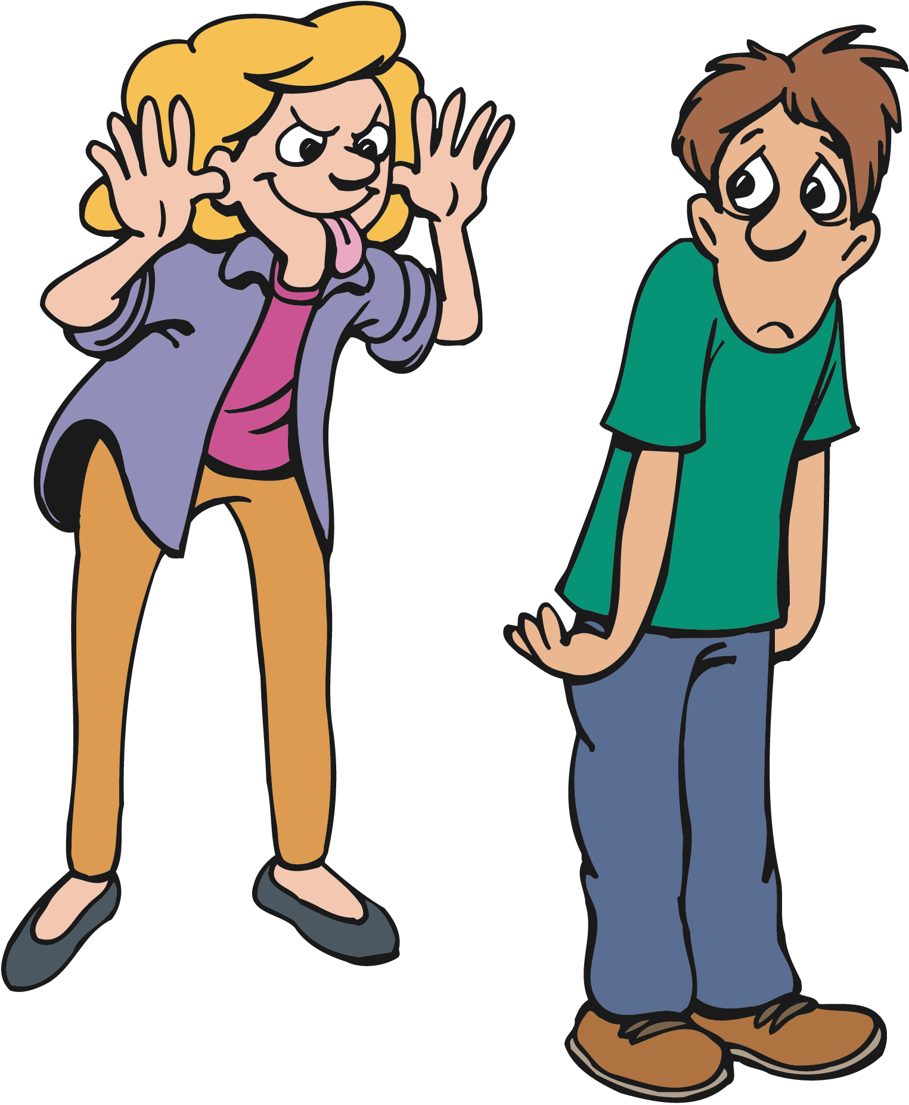
What is ‘Bullying’?
Bullying is when someone is intentionally mean or hurtful to another person over and over again, even when they have been asked to stop! Activity!
Discuss what things might a bully do to someone?

Slide 3
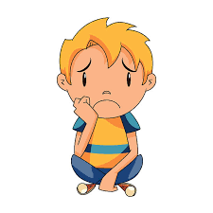
The Actions of a bully...
A bully might do things like:
teasing or name-calling
picking on someone and trying to make them feel bad
spreading rumours about someone
leaving someone out to hurt their feelings.
making someone feel sad, mad, scared, unliked and alone
trying to have power over someone
saying or doing mean things that upset someone
sending hurtful notes, emails or texts.
The important thing to remember, is that they will do these repeatedly to a person.

Slide 4
Where can bullying happen?
Bullying can happen anywhere!
on the way to school
at school
in the playground
on excursions or camps
on the phone or on the internet.

Slide 5
Bullying is not ok!
•You have the right to feel safe.
•Bullying causes great harm.
•If someone gets bullied, it is not their fault.
•Schools should be safe from bullying.
•Bullying is everyone’s problem.
•Put-downs are not okay.
•Think for yourself, do not follow others.

Slide 6
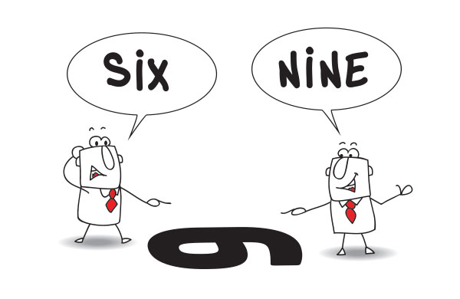
What Bullying is not
Bullying is not…
disliking someone: we will not always get along with everyone around us.
having a disagreement: we all like different things and have different ideas.
being bossy: some people are more confident and enjoy being a leader
choosing not to play with someone or not inviting them to a party: we often like to play with and be around certain groups of people over others.
This is okay! Because we are all different, like different things and like different people we meet for many reasons.

Slide 7
A Friendship problem is not bullying!
Sometimes we have arguments and disagreements with our friends. This is normal. If it happens once in a while, it is not bullying.
Optional Activity:
Discuss your ideas about friendship problems that are not bullying.
Record your ideas on a sticky note and stick it onto the board.
Share your ideas with your classmates.

Slide 9
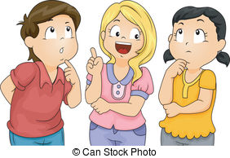
IS IT BULLYING?
ACTIVITY: Discuss the next scenarios as a class and decide if you believe it is ‘Bullying’ or not. If you are unsure, think about what would make the scenario Bullying?

Slide 10
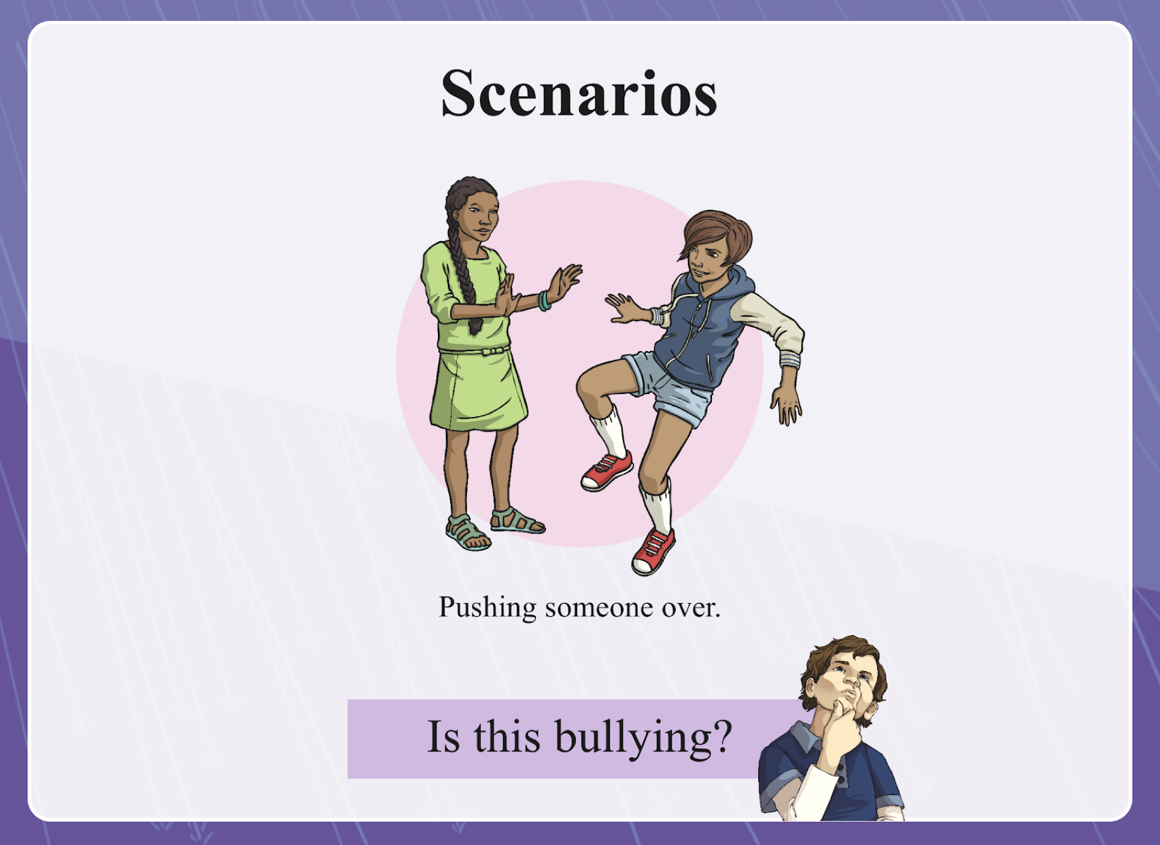
IS IT BULLYING?
Accidentally pushing someone over in a game!

Slide 11
IS IT BULLYING?
Whispering mean things to a friend
about someone else every day, to hurt that person.

Slide 12
IS IT BULLYING?

Slide 13
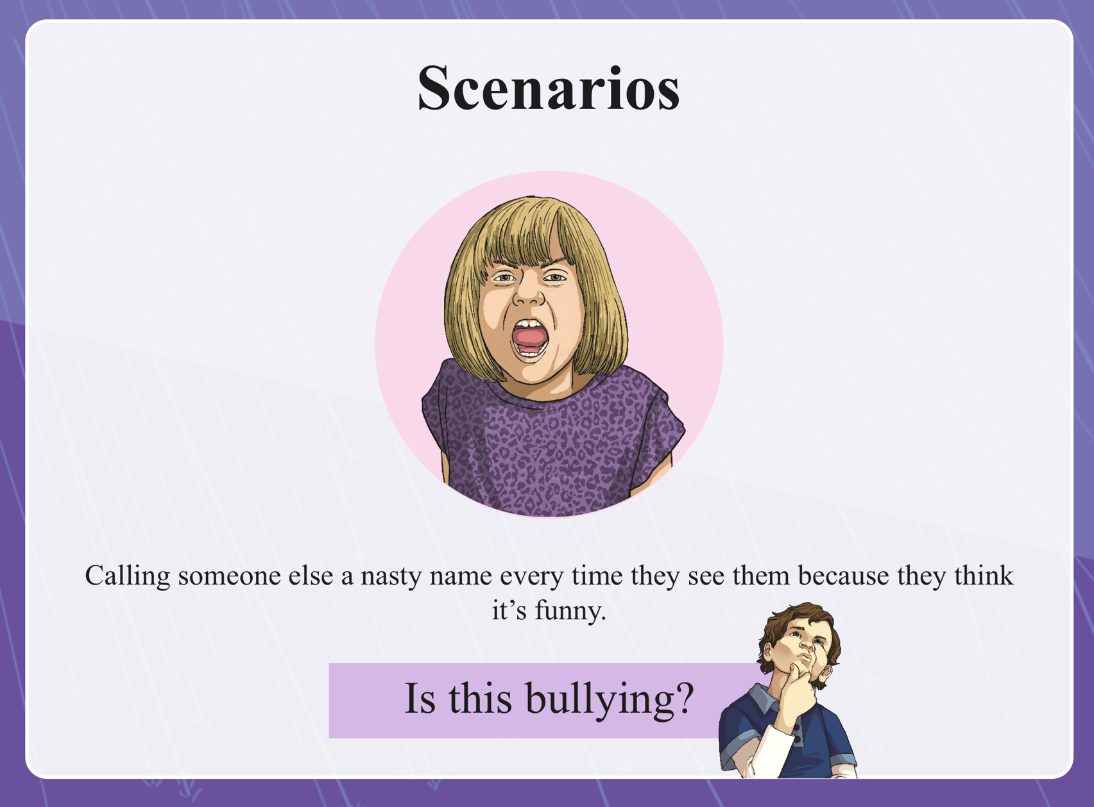
IS IT BULLYING?

Slide 14
What can you do if you see a bully or are being bullied?
Follow our 2 and 3 step plan!!!

Slide 15
Our 3 Step-Plan

Slide 16
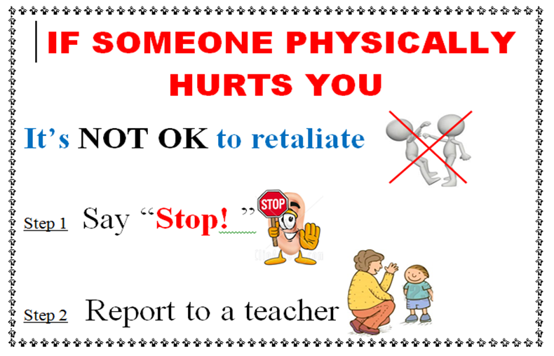
Our 2 Step-Plan

Slide 17
What do you do?
If someone says to you “stop I don’t like that!”
What should you do?

Slide 18
Imagine a world free from bullying
https://www.youtube.com/watch?v=xo2wRvJ04ss
Watch the video and discuss what the world would be like if it was full of chocolate!
Activity:
https://www.youtube.com/watch?v=xo2wRvJ04ss
Watch cadbury ad Discuss what the world was like with chocolate everywhere
Pose question imagine a world free from bullying
Use speech bubbles to draw or write answer independently
Display in classroom

Slide 19
Using the thought bubble templates, draw or write what the world would be like without bullying.
Share your thought bubbles with your classmates and display in your classroom.

Slide 20
Take a note from Kid President!
Watch the clip from Kid President!
Things we should say more often!
Activity: Puzzle pieces! Write or draw something we should SAY or DO more often! Things that will make our world a better place; one that is free of bullying! bullying!

